Slide 1
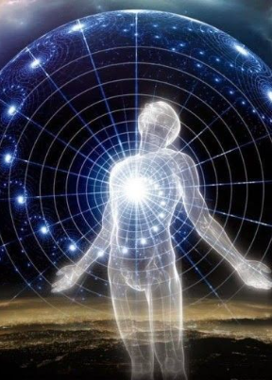

Coopwood diversity leadership & education universal
Transformation to the Next Diversity Paradigm
Ken Coopwood, Sr., Ph.D., CDE, CDROI CEO, Coop Di Leu
INAUGURAL COMMUNITY COLLEGE DIVERSITY INSTITTUTE – September 22-24, 2021 – PITTSBURGH, PA

Slide 2
THE STIMULI FOR NEW PARADIGMS
2019
COVID – IMPEACHMENT - PROTESTS
2021
INSURRECTION – DELTA – RETURN TO CAMPUS!
2020
FLOYD – BIDEN – WIENSTEIN – KOBE - PANDEMIC
Notes:
The events over the last three years have set the stage for paradigm shifting in how education is delivered. Some say these are the years from hell. Others say it’s about time you noticed the hell in the years. Considering what’s on the screen – what are the challenges that face America and the rest of the world about racism, equality, health, workplace dynamics, life planning, injustice, and returning to a campus as a microcosm of all these things? How has higher education responded in general? Here’s one way that is sweeping the country.

Slide 3
Diversity Professional Paradoxes:
Expected to follow first and lead second
Solve long-term problems within short tenures
Impact campus wide with silo-sized budgets
Reveal truth without exposing the past
Diversity Professional Imperatives:
Address the predisposition about diversity leadership
Establish an executive presence
Learn why their hire took place
Gain deep understanding of how fundamental change occurs
WE
NEED
A
CDO!
Notes:
So many jobs have titles and responsibilities associated with the inaugural term for the role – Chief Diversity Officer. Just like anything else new on the screen, the name has evolved over the past several years – each time it seems to reflect more about what the problem the incumbent is expected to solve. We’ve got Chief Equity Officers – VP for Equity and Inclusion – Directors of Social Justice Institutes – even VP for Belonging, Awareness and Change Management. I once held the title of VP for Infrastructural Development & Design! Still – no matter the title, diversity professional have similar history across every sector, but especially in higher education. From my own research, I call these common occurrences the Diversity Professional Paradox. Let’s have a look at some of these commonalities. Still there is work to be accomplished and to be successful, certain imperatives must be illuminated and addressed. These are the items that are most central to the theme of our Institute – we must make a playbook of tactical and strategic plans to bring the imperatives for diversity professionals into fuition.

Slide 4
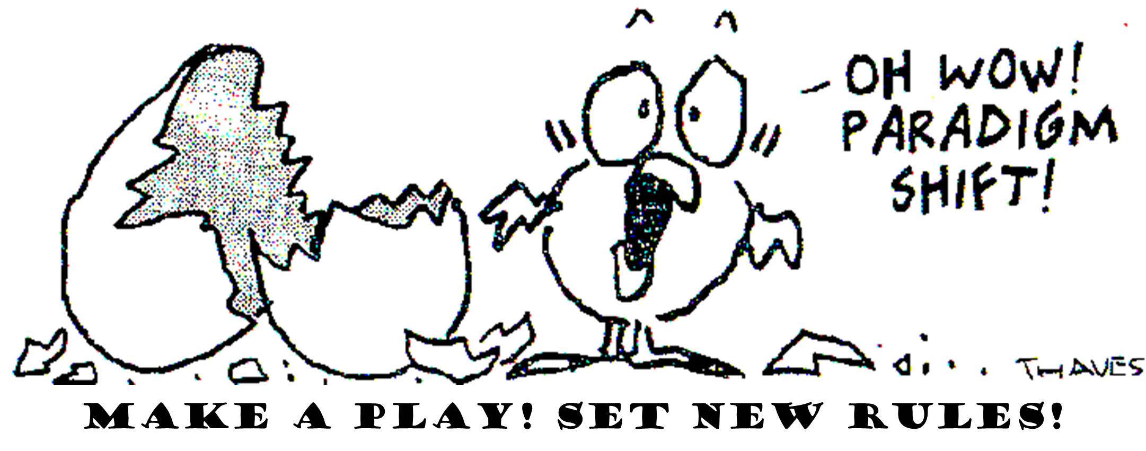
The DIVERSITY Professional: a new idea in an old PARADIGM
Paradigm – Patterns, processes and practices that form rules for recognition, expertise, support, equity, and problem solving. They do two things:
Establish limits or boundaries – just like a pattern establishes edges
Guides behaviors associated with success within the boundaries
Paradigm Shift – Operation under a new set of rules
Paradigm Paralysis – Stuck in the comfort of the current rules.
Few [institutions] are able to participate in the next wave of [diversity leadership and education] because they are blinded by the business at hand.”
– Edson deCastro, 1978
Notes:
Tactical and strategic planning should address the future more so than the present. But we have to play ball where we are – in our current paradigm – before we can up the game advance to new territory and rules for engagement. A paradigm is… The Story of Galileo Then go to video

Slide 5


What should diversity leaders do?
“If your actions inspire others to dream more, learn more, do more, and become more, you are a leader.”
John Quincy Adams

Slide 6
What should diversity leaders do?
Provide vision
Lead (to the future)and manage (the present)
Interpret the environment (explore context)
Empower & create teams (power dynamics)
Engage communities
Model behavior

Slide 7
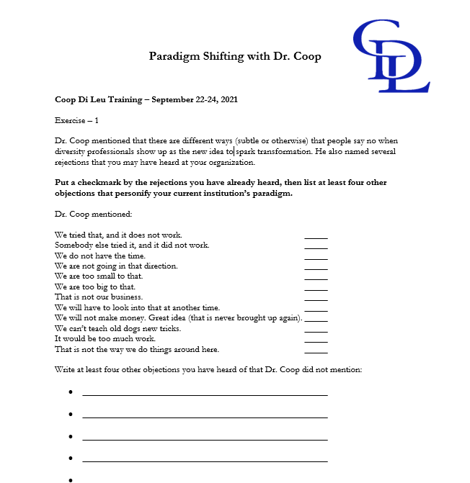
Warm-up One: Prepare for Resistance to Your Presence as the Idea for Transformation

Slide 8
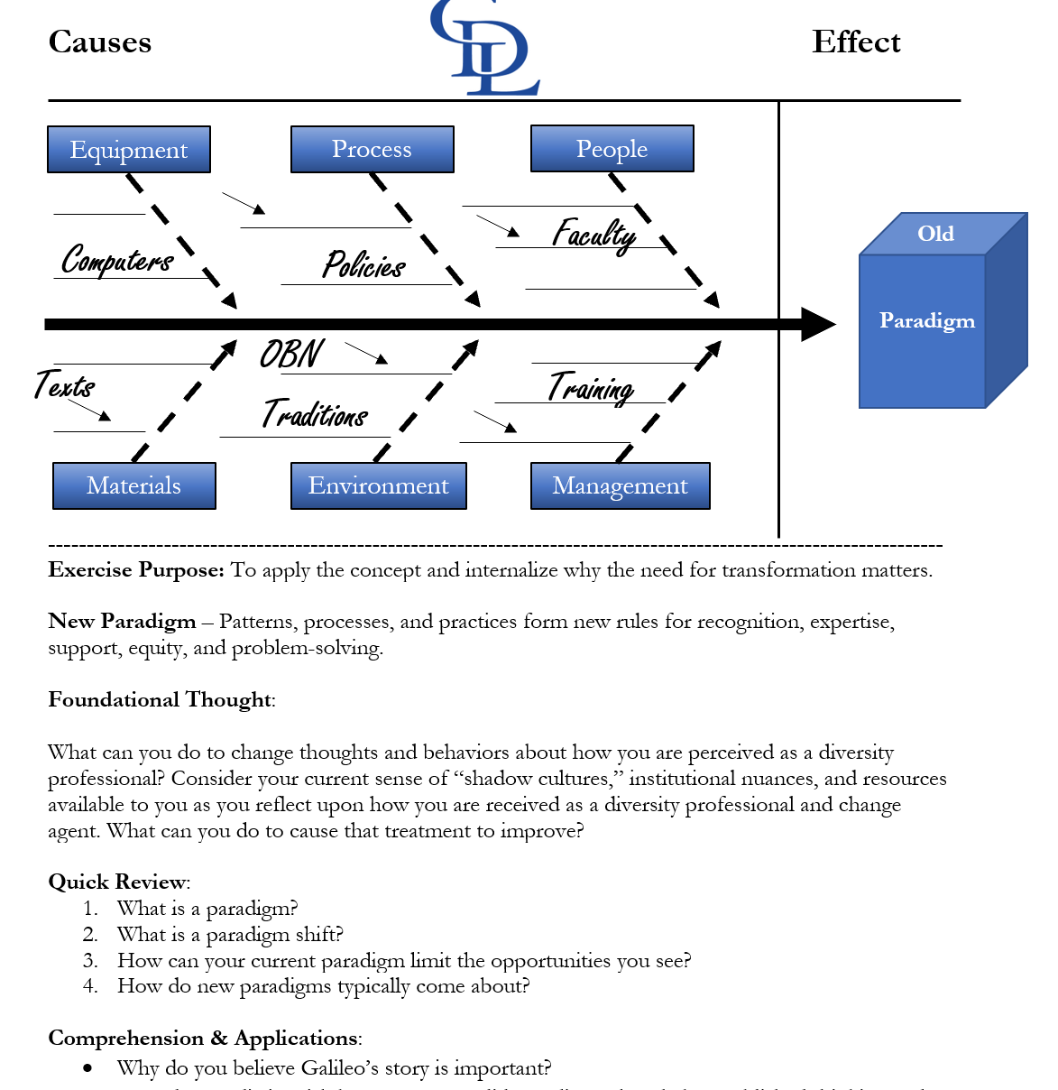
Warm-up Two: Identify your impossibilities for targeting, penetration, and elimination

Slide 9
Continuum to inclusive infrastructure
Inclusive
Compliant
Multicultural
Monocultural
Metzler, 2001
Notes:
The purpose of the two warm-ups is to get your mentally prepared to frame where your most imminent challenges may be. We often believe that we know our challenges well and this understandably due to the expectation for us to deal with the issues that are in our face everyday. But the real work about change is much deeper than a protest, or a disgruntled student, supervisor, or parent. Most issues we face simply request, or even demand, compliance. People who approach you with requests or demands most likely do so with the boundaries of the current paradigm in mind. In other words, this s what works for me NOW! As a result, inclusion is a futurist achievement. We have to first manage things within the frames of our current paradigm to get there.

Slide 10
Reframing organizations
Bolman and Deal
Structural
Symbolic
“A frame is a mental model – a set of ideas and assumptions – that you carry in your head to help you understand and negotiate a particular territory.”
Frames – are windows, maps, tools, lenses orientations, filters, prisms, and perspectives.
  Structural
  Human Resource
  Political
  Symbolic
Political
Human Resources
Political

Slide 11
structural frame
Explores the key role that social architecture plays in the functioning of an organization. Defined by two key assumptions: how to divide the work (differentiation) and how to coordinate the work once divided (integration).
This frame depends on:
  Vertical coordination (which includes establishing lines of authority, rules and policies, and planning and control systems).
  Lateral coordination (includes formal and informal meetings, task forces, influential relationships to synchronize roles, matrix structures wherein people have more that one supervisor, and technological and inter-organizational networks).

Slide 12
Human resource frame
This frame highlights the importance of “fit” between an organization and the individuals who form the organization.
  Emphasis is on motivation and the factors (such as needs, motives, and personality) that can enhance or stunt a person’s commitment to work.
  Developing the best possible mutually beneficial relationship, individuals must feel they are engaged in meaningful work for their organization so the organization can benefit from the full talent and potential of its members.
  Shared Governance in Higher Education, Edited by Sharon F. Cramer.
  SUNY Press 2017. Chapter 10. Heather D. Maldonado p. 217-228.

Slide 13
political frame
The assumptions of the political frame characterize organizations as coalitions of constituencies with diverse interests that compete over scarce resources and arrive at decisions through bargaining and negotiation.
  Power is what is utilized to benefit one’s constituency
  Power can be much broader than authority because it capitalizes on networks of influence
  Should be viewed to achieve group goals
  Due to structure and scarcity conflict is often a part of the political frame.

Slide 14
Symbolic frame
The major emphasis is on culture, symbols, and spirit as keys to organizational success. Draws on social and cultural anthropology, treating organizations as temples, tribes, theaters, or carnivals.
  Depicts organizations as cultures, propelled by rituals, ceremonies, stories, heroes, and myths
  Not influenced by rules, policies, and managerial authority.

Slide 15
Overview of the frame model
 | STRUCTURAL | HUMAN RESOURCE | POLITICAL | SYMBOLIC
Metaphor for organization | Factory or machine | Family | Jungle | Carnival, temple, theater
Central Concepts | Rules, roles, goals, policies, technology, environment | Needs, skills, relationships | Power, conflict, competition, organizational politics | Culture, meaning metaphor, ritual, ceremony, stories, heroes
Image of leadership | Social architecture | Empowerment | Advocacy and political savvy | Inspiration
Basic leadership challenge | Attune structure to task, technology, environment | Align organizational and human needs | Develop agenda and power base | Create faith, beauty, meaning
Bolman, Lee, and Terrence E. Deal. (2008). Reframing organizations: Artistry, choice, and leadership. 4th ed.
San Francisco: Jossey-Bass.

Slide 16
Where are you most challenged?
Let’s Vote & Note:
VERTICAL & HORIZONTAL PLANNING!

Slide 17
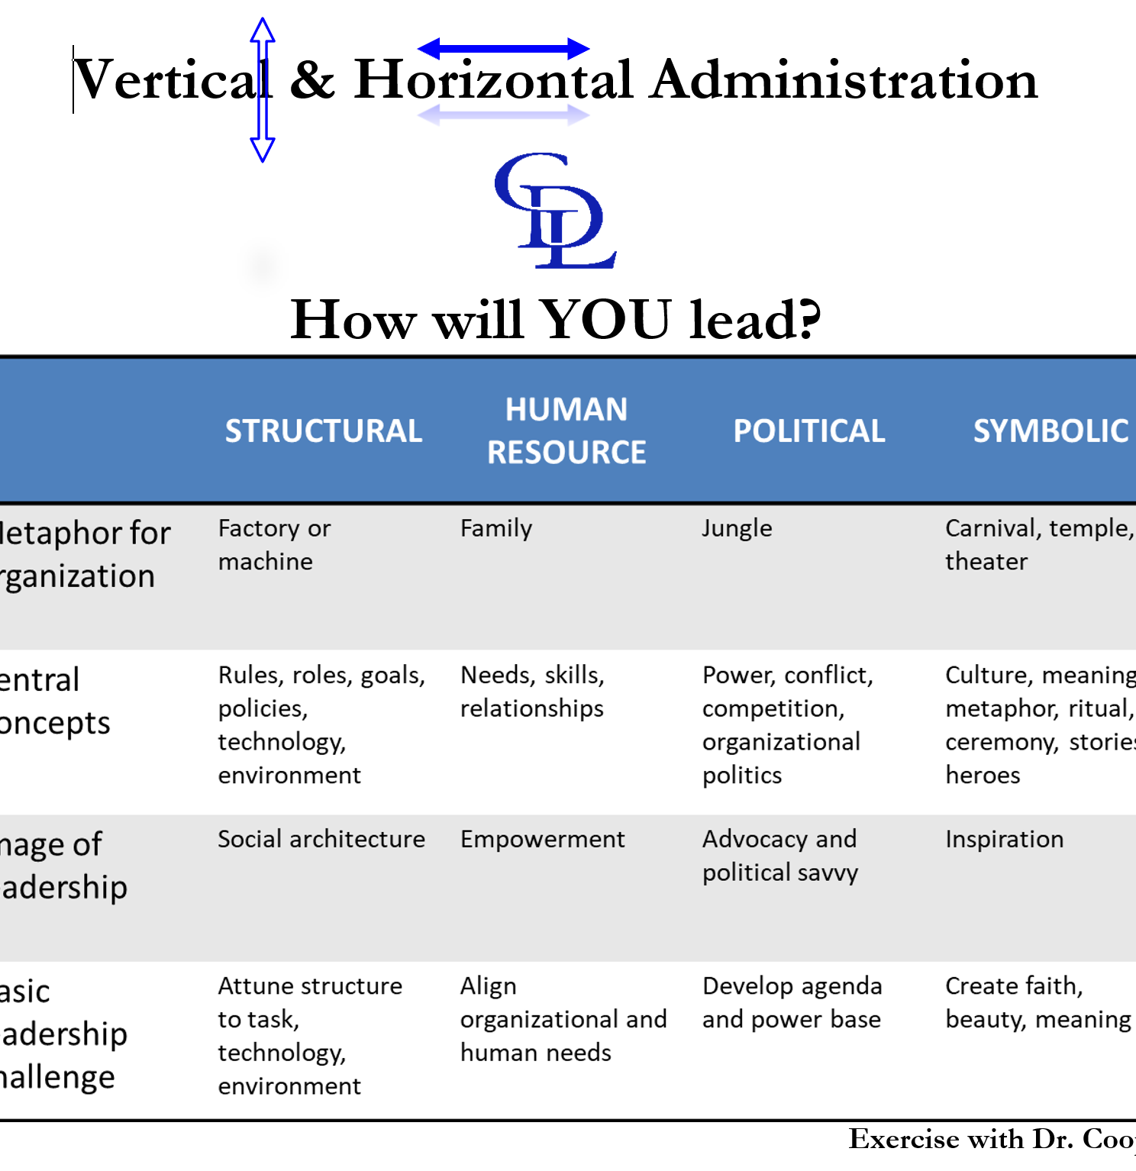
Make a Play: Decide your 90-day game plan to jump start transformation at your college

Slide 18
h.u.s.t.l.e. in your frame
The Making of a 21st century diversity champion
“Those who have not must hustle, those who have must hustle to keep” – Theodore R. Coopwood, Jr.
H
U
S
T
L
E
umility – Interface leadership, Servanthood, Peacemaker, Selflessness, Humanism
tility – Usefulness, Purpose, Resourceful
ubstance and Sustainability – Worth, Relevance, Distinction
enacity – Courage, Strength, Faith, Resilience
eadership – Philosophy, Vision, Mission
xecution – Thought, Behavior, Habits
We are CHOSEN to represent those who are not present and to empower those who are in the fold. Diversity work of any kind is futile without equity, and WE are responsible for obtaining a fair share of resources, space, respect, grace, and representation for the COMMON good of our society and underserved populations.

Slide 19
Coop Di Leu
Advancing a New Worldview for Transformative Diversity Leadership
H.U.S.T.L.E. to Excellence!
www.coopdileu.com

