Slide 1


ADVANCING DIVERSITY
For Special Student Populations
Dr. Angela Long
Director, Strategic Engagement
Tallahassee Community College
September 22, 2021

Slide 2
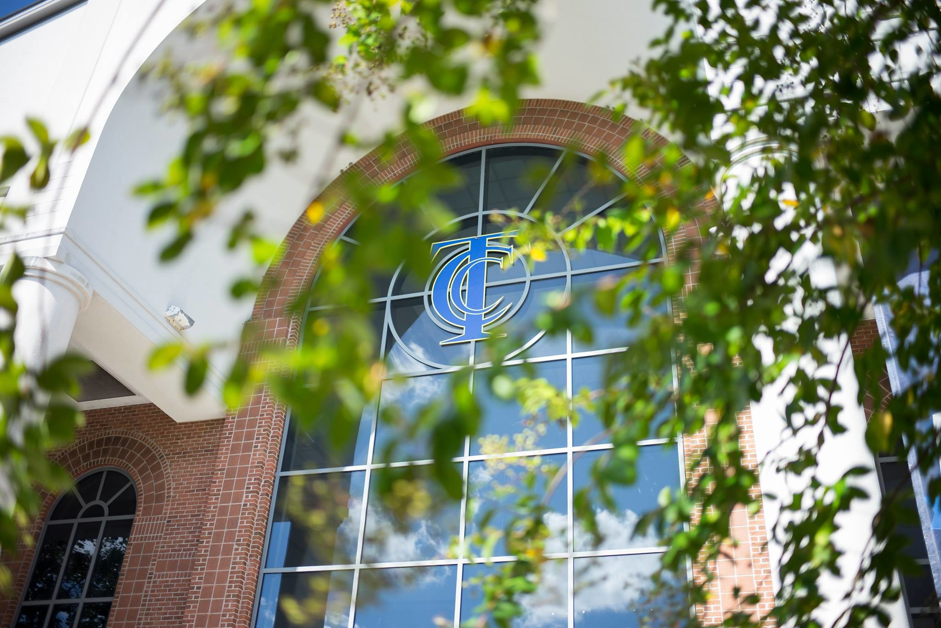
Higher Education in a 21st Century World

Slide 3


Slide 4

85% of Jobs in 2030 haven’t been invented yet. . .
AND . ..60% of jobs will be AUTOMATED
- The Institute for the Future

Slide 5
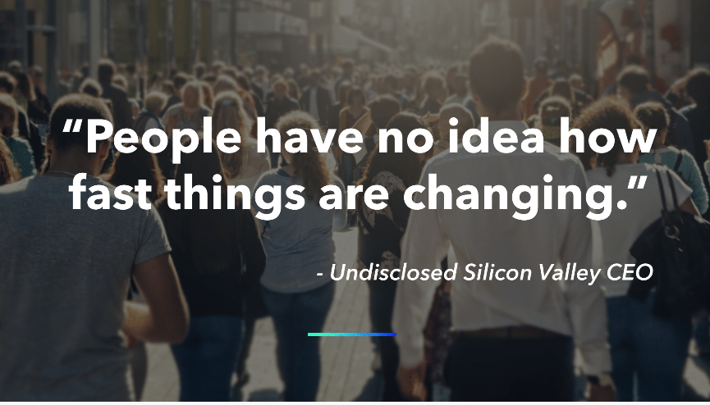

Slide 6
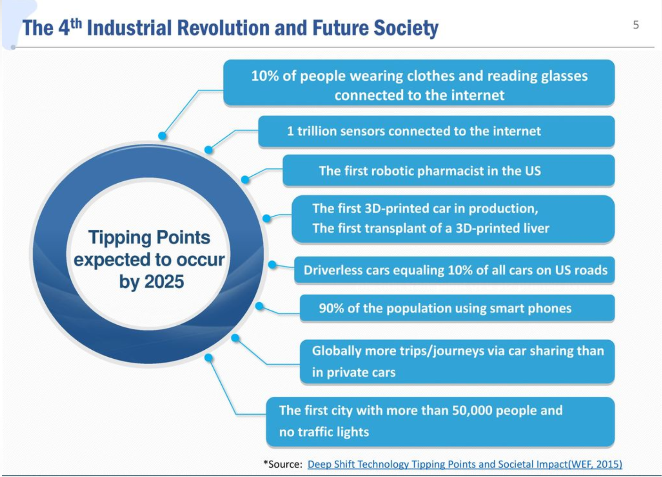

Slide 7
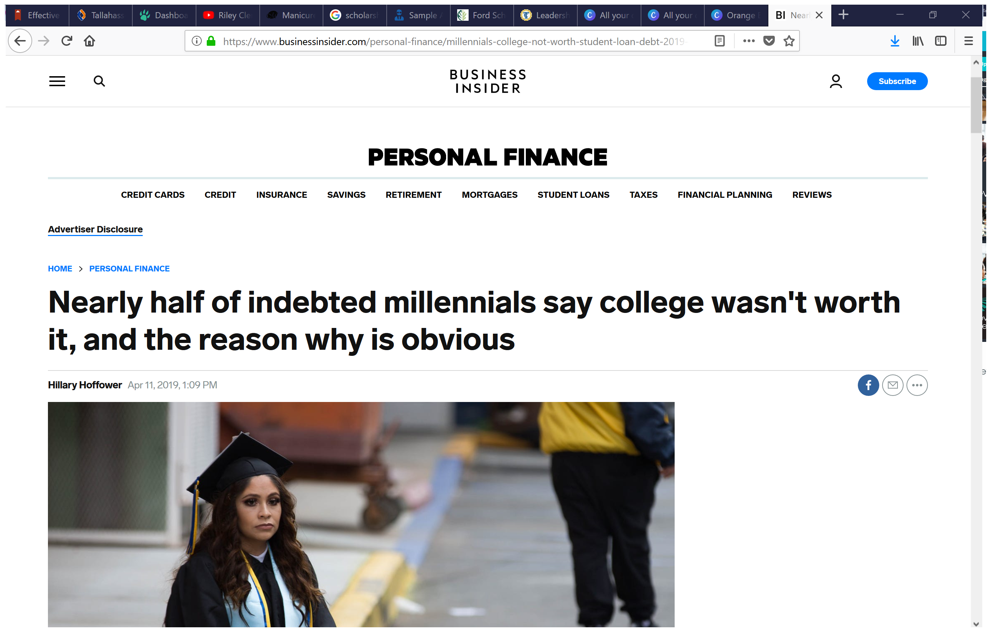
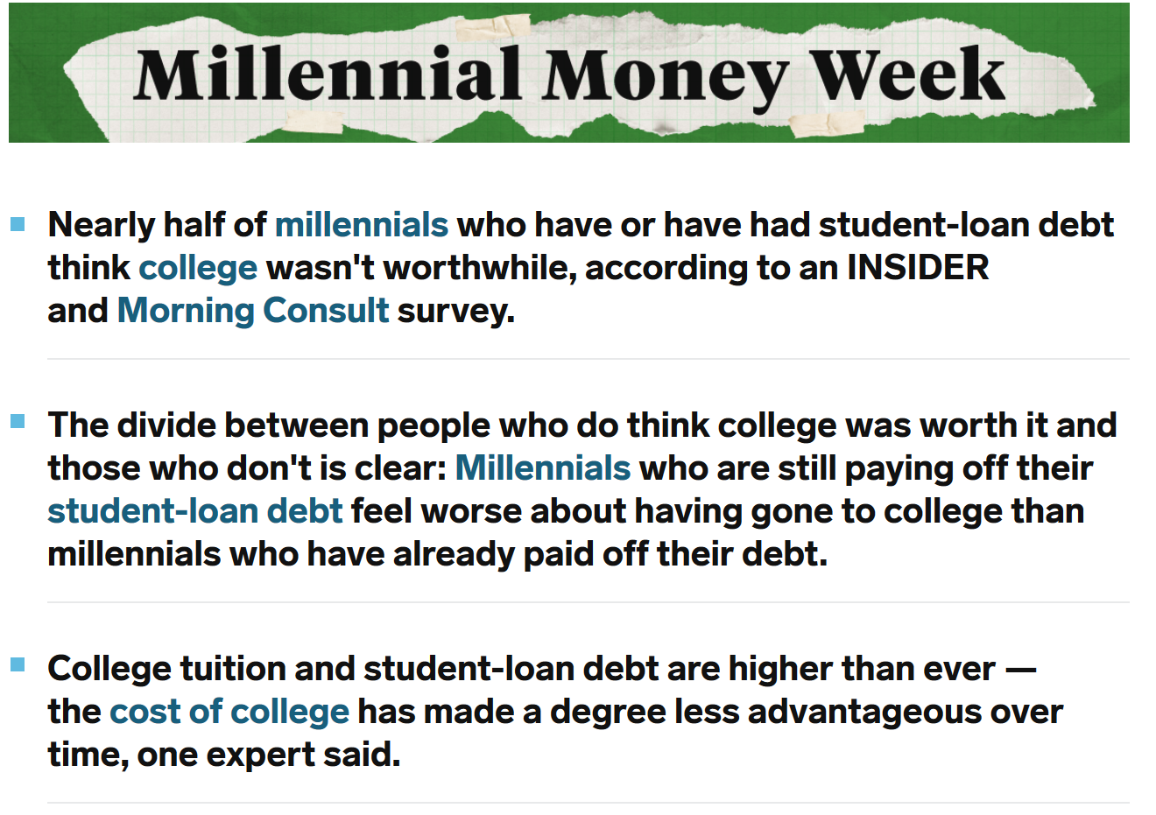

Slide 8
Educational Relevancy is a Global Issue
50% YOUTH AROUND THE WORLD DON’T BELIEVE THEIR POSTSECONDARY EDUCATION WILL HELP THEM GET JOBS.
40% OF EMPLOYERS SAY LACK OF SKILLS ARE MISSING FOR EVEN ENTRY LEVEL POSITIONS.
72% OF PROVIDERS SAY THEY HAVE THE SKILLS.
McKinsey 2017
© Global Foresight 2017 all rights reserved  www.global-foresight.net  mohara@global-foresight.net

Slide 9
And now a pandemic…

Slide 10
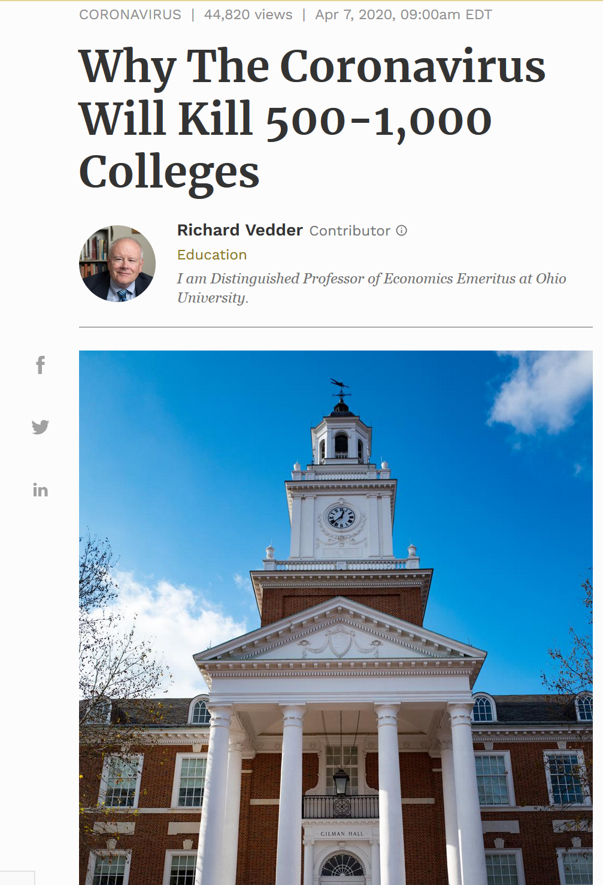
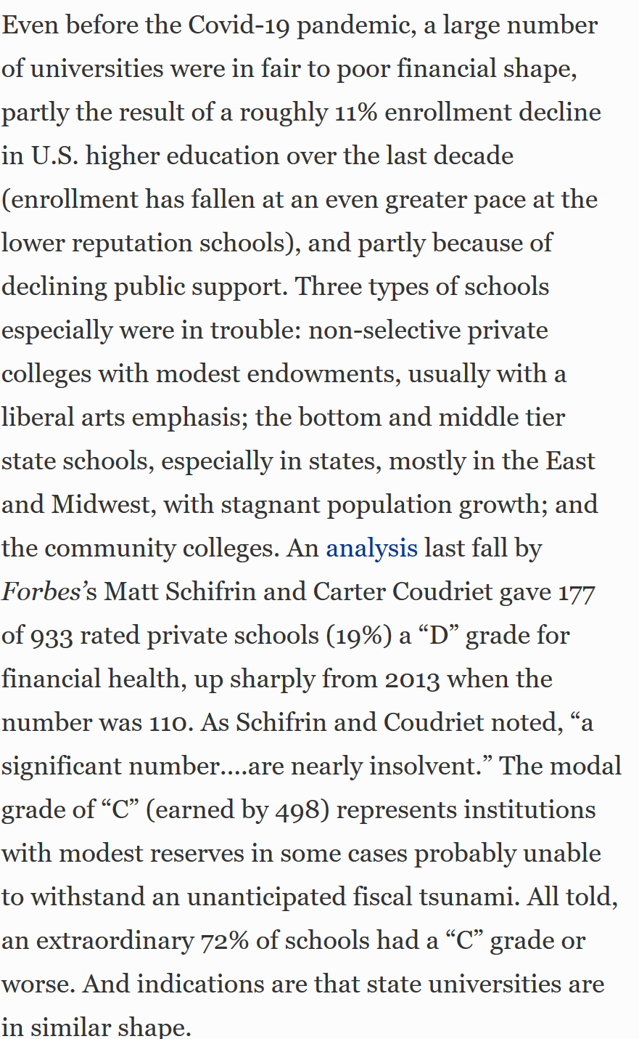

Slide 11
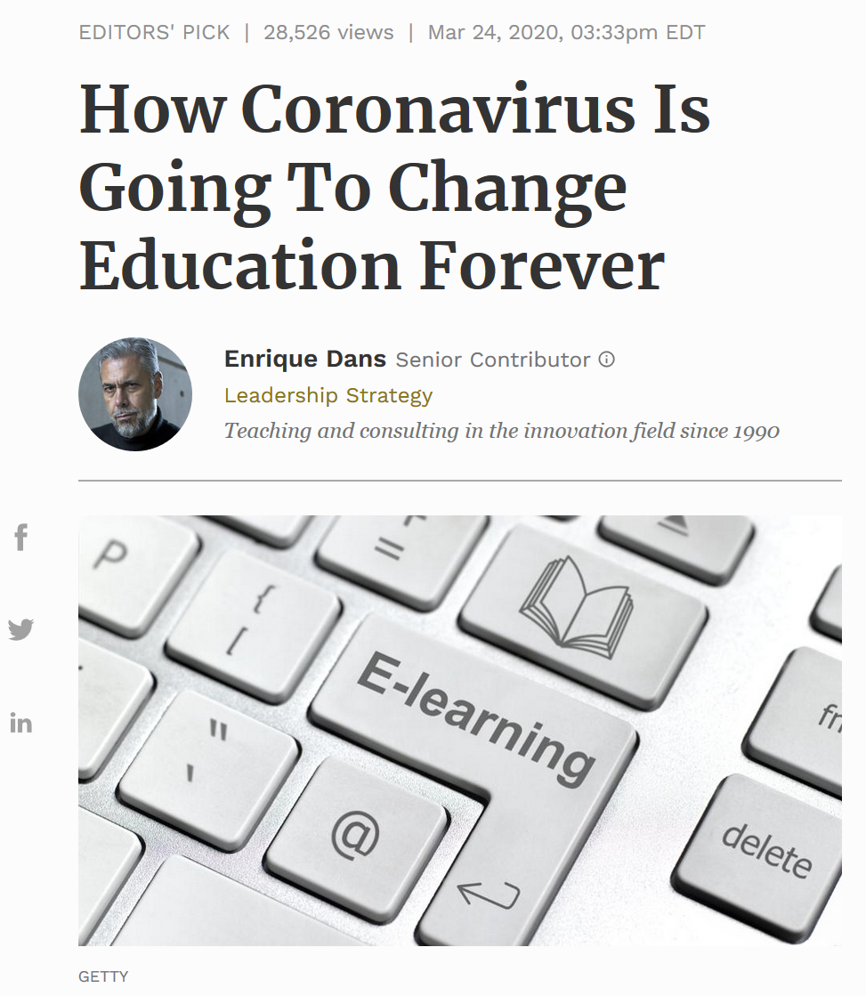

Do You Agree?

Slide 12
Community Colleges at a Racial Crossroads

Slide 13

Community Colleges and the American Dream
“Equal opportunity for all persons, to the maximum of their individual abilities and without regard to economic status, race, creed, color, sex, national origin, or ancestry is a major goal of American democracy. Only an informed, thoughtful, tolerant people can develop and maintain a free society.”
- 1947 Truman Commission on Higher Education

Slide 14
“But while community colleges have historically prided themselves on being the welcoming entry point to higher learning and a change agent for millions, we must now acknowledge that access is not enough. For without the means and a pathway to succeed, access is an empty promise.”
- Dr. Walter Bumphus, President, AACC

Slide 15
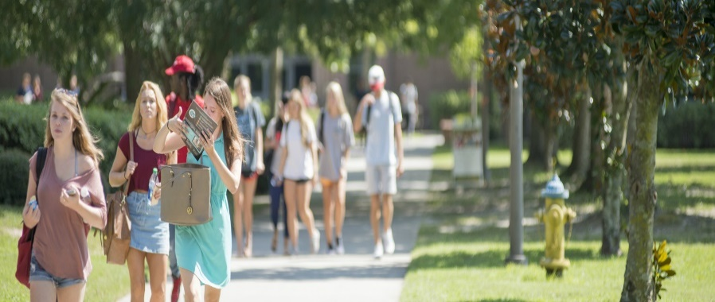
America’s Community Colleges stand at a Major Crossroads
Demographic Shift to a Majority-minority nation.
Academic Under Preparedness.
  The average college freshman has a seventh-grade reading level and an eighth grade math skill level.
  Approximately 70% of community college freshmen take a remedial class in mathematics.
Poor Completion and Attainment Rates.
  Nearly half of all community college students entering in the fall term drop out before the second fall term begins.
  For Students of Color, it is far worse: Approximately 70% (7 out of 10) attending a community college, drop-out prematurely.
        Of those who remain, only 10-12% graduate.
    For Caucasian students attending a community college, 44% live in poverty.
      - Only 2 out of 10 graduate!

Slide 16
Reclaiming the American Dream
“The Community College landscape is littered with lost credits that do not add up to student success. Fewer than half (46%) of students who enter community colleges with the goal of earning a degree or certificate have attained that goal, transferred to a baccalaureate institution, or are still enrolled six years later. The rates, unfortunately, are lower for Hispanic, Black, Native American, and low-income students…Completion rates for students of color in some groups – often those students facing the greatest challenges – are disappointing in the extreme.”
- AACC, 2014 (Reclaiming the American Dream Report)

Slide 17

Analyzing 5 Key Student Demographics in the U.S.
2016 Publication
Black
Hispanic
Asian American/Pacific Islander
American Indian/Native American
Caucasian Students in Poverty

Slide 18
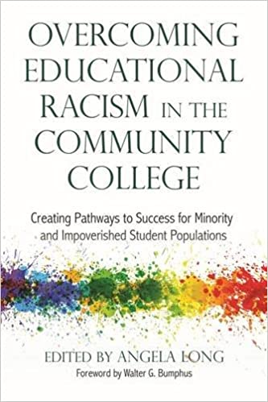
African American Students in Community Colleges
“Black students represent one of the most key demographic sub-groups served by community colleges. Simply put, Black students are the greatest challenge and opportunity for postsecondary institutions. Such students are among those most underserved by community colleges. These institutions overwhelmingly fail to provide necessary supports and environments that foster success among these students.”
- Dr. J. Luke Wood and Dr. Glennda Bivens, 2016

Slide 19
Why the Disparity?
    In one study, African American students expressed higher educational aspirations in comparison to any other racial sub-group, meaning African American students were overwhelmingly more likely to indicate at the point of the admissions application that they want to achieve a long term educational goal, such as transfer or associated degree completion.
    The review of our data reveals that African American students who are college prepared outperformed their African American peers who were not college ready, but did not succeed at the same rate as their Asian and white peers who also entered the college with the same level of preparation.
    This type of examination has profound implications for those who work within the community colleges because it highlights the fact that something structural exists within the foundation of our colleges that is impeding the success of African American students.
    - Moore and Bush, Chapter 3
Notes:
Socioeconomic/Work Status:
58.5% of Black Men vs 65.3% of Black women in CC.’s are low-income (make less than $25,000/year).
59.8% of Black men work while attending school vs. 68.3 % of Black women work (49% full-time).
28.3% of Black men have dependents vs. 55.6% of Black women enrolled in community colleges.
41% of Black men are enrolled in community colleges vs. 37.6% of Black women are enrolled in community colleges.

Slide 20
Poverty Perspective
“…many barriers emanate from the structure of our social system. Many of these barriers are the result of the way institutions are currently organized, and stem from the values and perspectives that people in poverty adopt from the daily conditions they experience. In most cases, the fact that many of the barriers have systemic roots is invisible, even to people in poverty”. – Dr. Ed Hughes
From both a poverty and racial perspective, is there a systemic “root” partly responsible for explaining why so many students of color and the impoverished do not find their sense of belonging and are not performing at the same rate as middle to upper class students?
– Chapter 16

Slide 21
Defining Educational Racism
“A cultural bias manifested either overtly or covertly by a system of education and educators that benefits or punishes students based on their culture, racial background, ethnicity, socioeconomic status, creed or ideologies.”
– Overcoming Educational Racism in the Community College, 2016.
What are the conscious and unconscious practices that permeate the community college system that must be addressed to create conducive learning environment for students of color and those in poverty?
Notes:
Are minority students at community colleges disadvantaged by “educational racism,” defined as a “a
systemic network of rules, expectations, and cultural values based upon a model of education
that caters to a middle and upper class white mindset in America?”

Slide 22
Ways We Communicate Bias
  Examples include:
    Advising: Steering students toward select majors based upon perceptions
    Instructional Materials
    Curriculum and Syllabus
    Verbal Exchanges
    Non-verbal interactions – Misreading student body language or behavior
    Attendance based policies such as “no admittance once class begins” and “no children in class, no exceptions” and “bring a doctor’s note if out” are all examples of policies that drive barriers between students of poverty and the college.
    Punishing or grading students down for expressing views and ideologies, appearing disengaged.
    Ignoring students, experiencing rejection from peers on group assignments, verbal assaults.
“You are so articulate!”
“This is a calculus class. Are you sure you’re in the right place?”
“When we would have group projects, I would be the last to be picked because they assumed I don’t know as much as they do.”
“There have been times I have answered a question, and I get responses like ‘Wow! I didn’t expect you to know that!”
              - J. Luke Wood, 2016
Notes:
African American male students on predominantly white campuses perceive that the institutional
environment is adversarial, citing greater feelings of unfair treatment, a devaluing of their
academic capabilities, and increasing discriminatory or racist practices. As a result, the
implications of these perceived institutional characteristics have impacted the academic
outcomes of both African American men and women attending both HBCUs and predominantly
white institutions (Allen, &amp; Jewell, 2002; Holmes, Ebbers, Robinson, &amp; Mugenda, 2001;
Mallinckrodt, 1988).
Our experience has shown us the majority of discipline complaints from non-African American faculty are issues of cultural
disconnection masked in the form of student behavioral issues. This is an issue for both African
American males and females. We have found that some instructors hold conscious and
unconscious bias and fear of African American students associated with the societal portrayal of
this particular population. To get complaints from faculty regarding students who are talking in
class, or are disengaged, intimidating, and loud are common complaints for African American
students and far exceed similar complaints about any other student population.

Slide 23
Ways Students Receive Bias
  Examples include:
  Internalizing covert messages from their experiences that they are different and inferior. Examples of these messages include waiting in long lines for services, a take-your-number-and-wait culture, nonverbal negative reactions from others, and a general lack of respect shown to them in many situations.
  A belief in a very limited future that does not include future oriented goals. A pervasive self-view that “I’m not good enough…”
  A low expectation of what education can do, including a view that education and schooling is just another stress of life that might not be worth it.
  I don’t belong here!

Slide 24
Key Findings
The researchers reported that the strongest determinants of faculty-student engagement were participation in learning communities, reading remediation, study skills courses, and college orientation.
Research posits that degree completion for students is due to sense of belonging (hausmann, schofield, &amp; woods, 2007).
Students that had interactions with faculty early in their postsecondary careers had higher levels of sense of belonging. The more peer support students had over time, the higher their sense of belonging.
Campus racial climate is an important factor in the ways in which students navigate their educational experiences (bush &amp; bush, 2010). Specifically, racial microaggressions (subtle racial insults) influence students psychologically and academically.

Slide 25

Universal Truths
All human beings share these common six traits:
    All humans want their physical and emotional needs to be met;
    All humans want their lives to be meaningful;
    All humans want to live happy lives;
    All humans want to be free of fear, injury, and sickness;
    All humans need to be loved by someone; and,
    All humans want to be treated with both fairness and respect by others.
Yet, students who leave say they do so because they feel as if THEY DO NOT BELONG!

Slide 26

If we are going to change the paradigm, we must be united and not divided…

Slide 27
Tallahassee Community College:
Building Pathways to Success

Slide 28
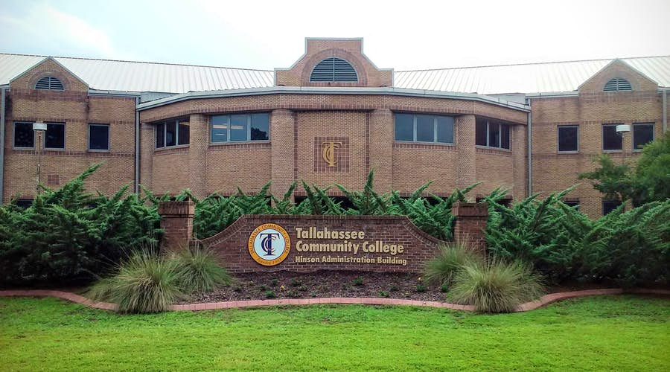
TCC Highlights: Who We Are
Enrollment Headcount: Approximately 11,000
Services: 3 Counties – Leon, Wakulla, Gadsden
Location: Situated in the poorest zip code (32304) in the state of Florida.
  Nearly 21% of the population for whom poverty status is determined in Leon County, FL (56.2k out of 274k people) live below the poverty line - 13.4% higher than national average.
  Near Florida’s Capitol Building, Florida State University, and FAMU
  Demographically Diverse: 60% Non-White

Slide 29
How might TCC redesign its student experience through an innovative model that removes barriers for all students to be successful?

Slide 30
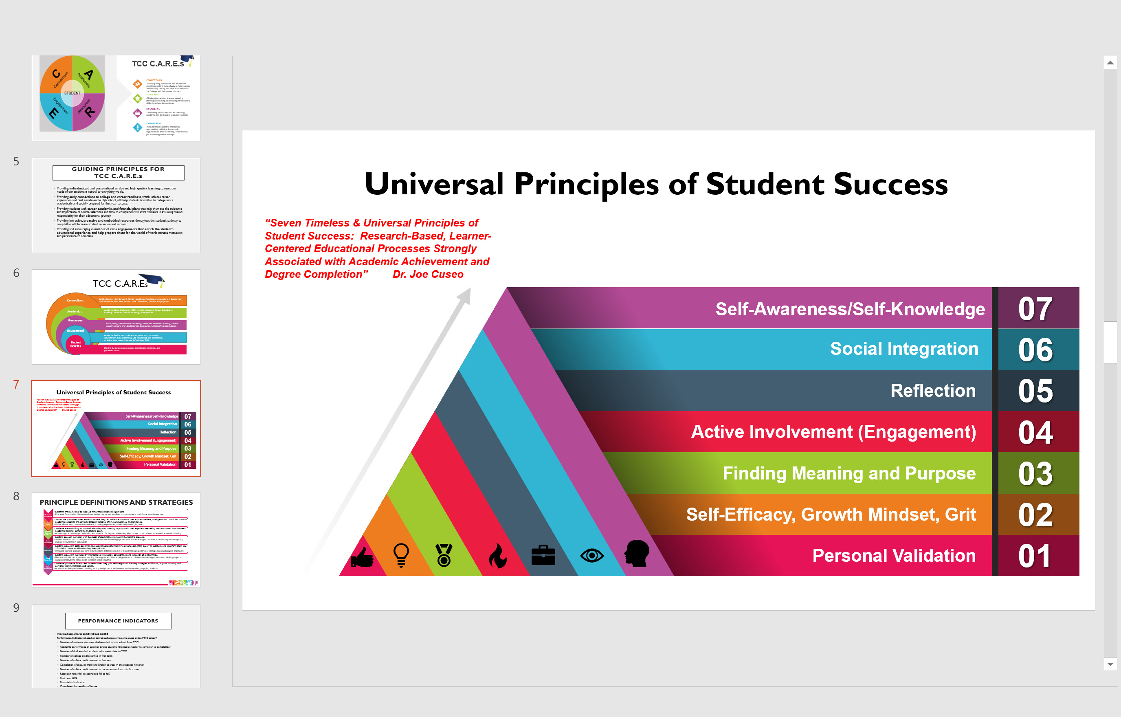
Seven Universal Principals of Student Success

Slide 31
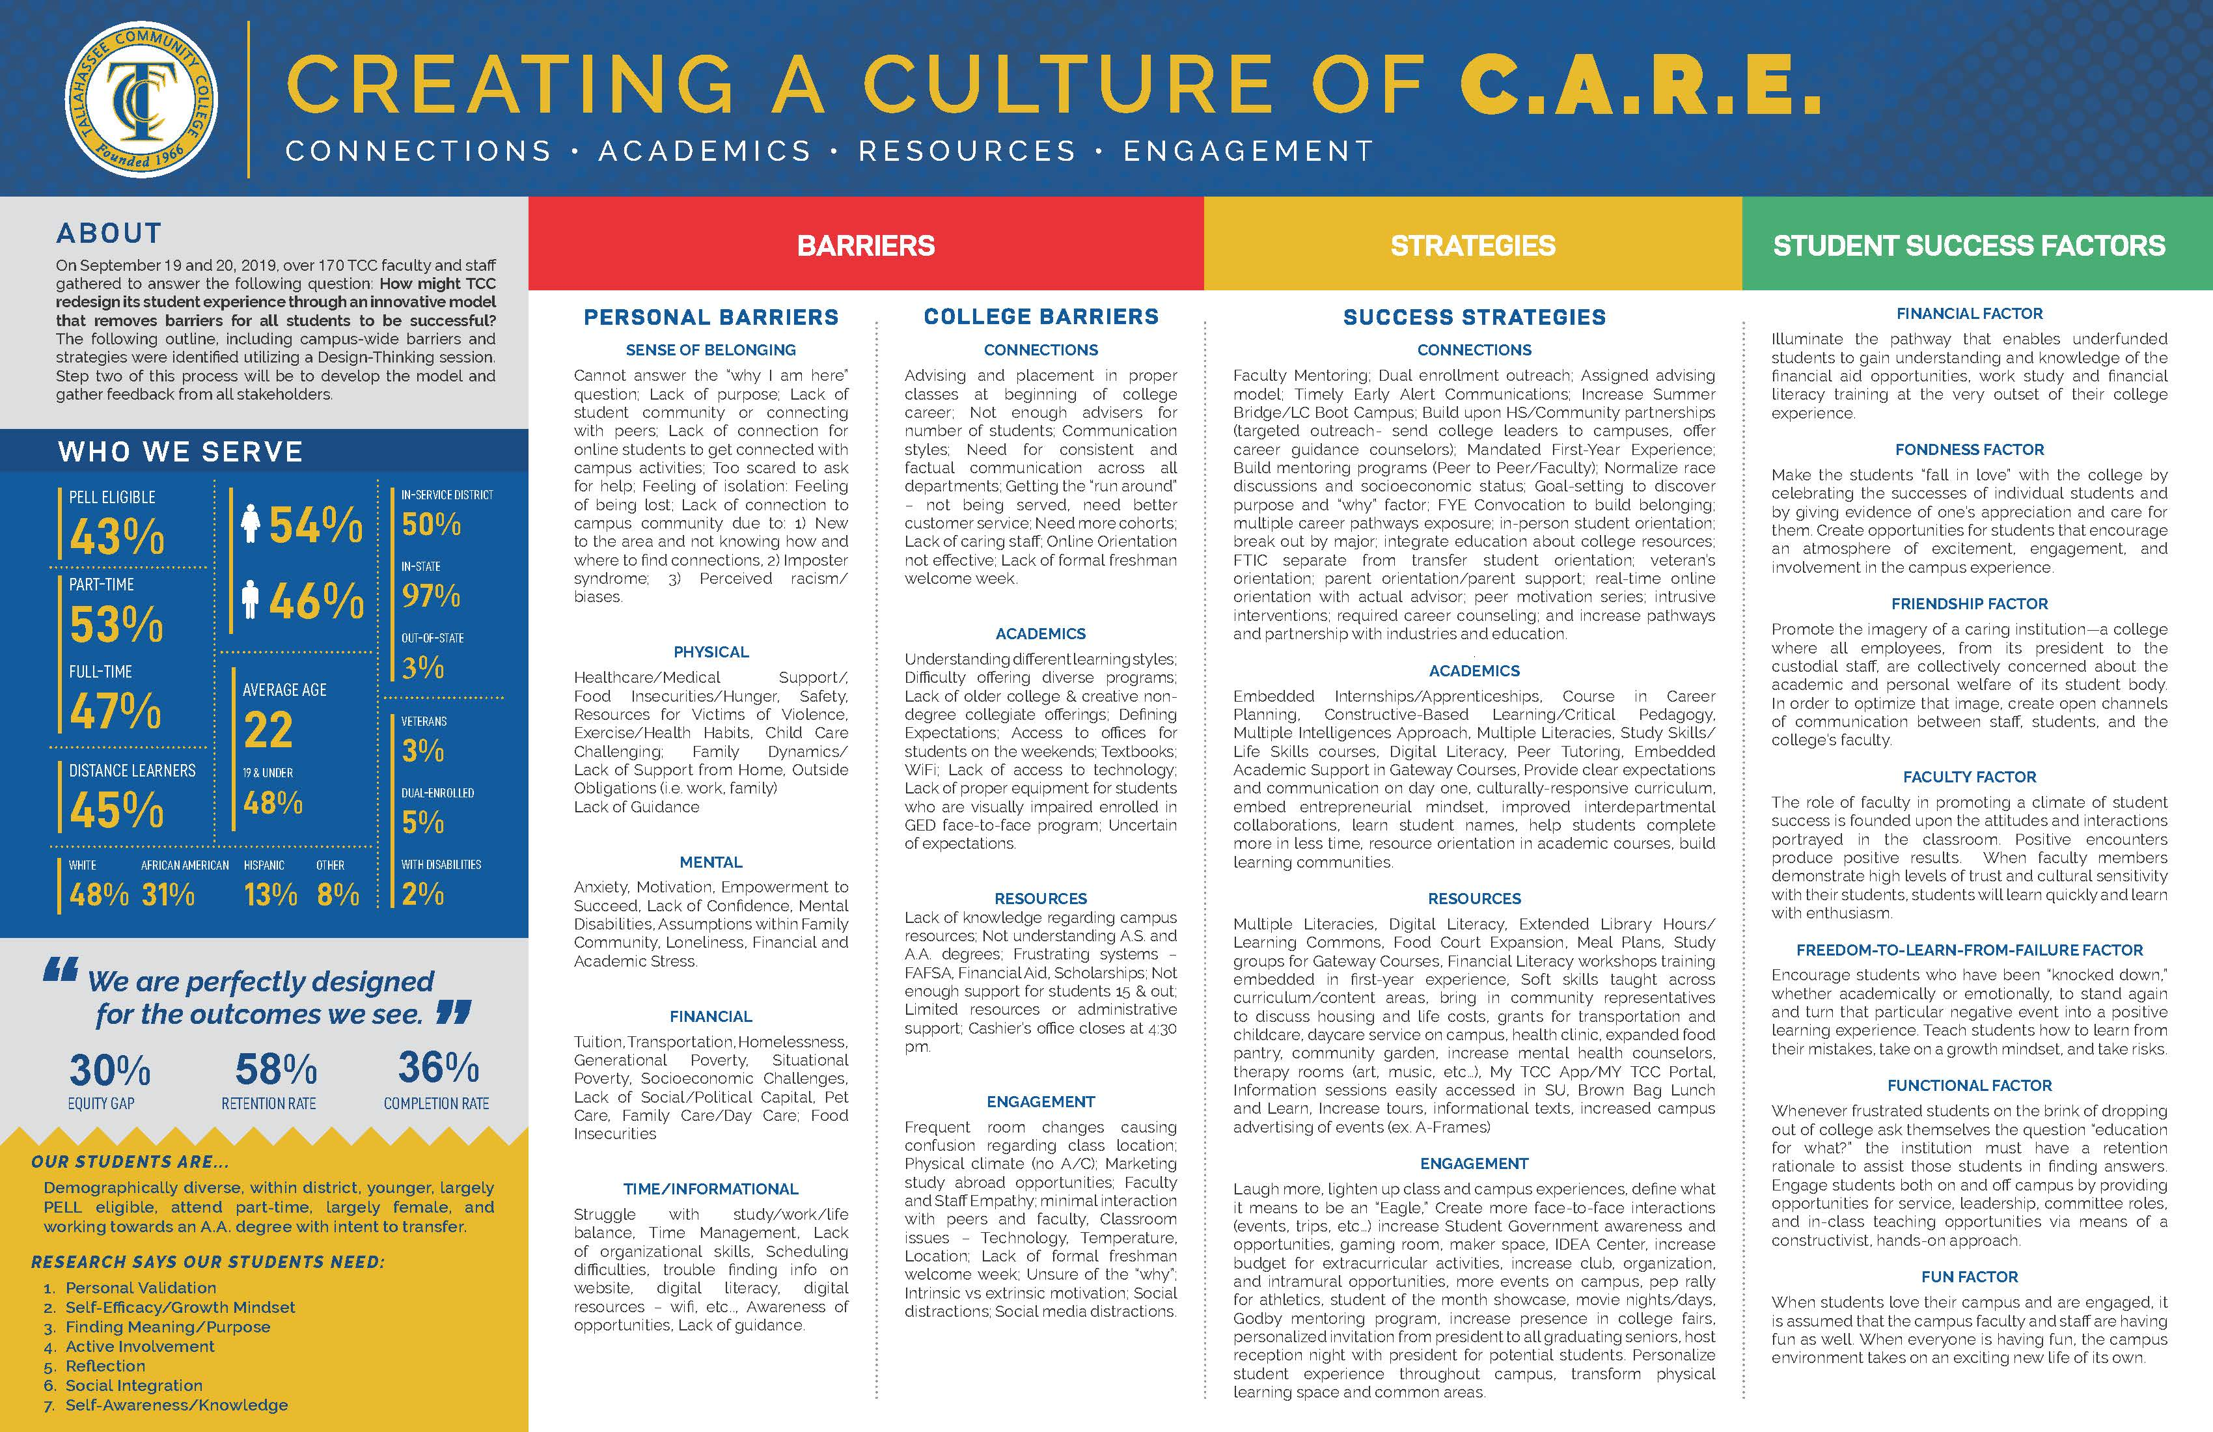

Slide 32

Creating a Culture of CARE

Slide 33



What Lessons Can Be Learned From Amazon, Chick-fil-a And Starbucks?

Slide 35

Embedded Academic Supports
Academic Success Coaches
Assigned to proactively monitor, text, email and call all FTIC students. Fall 2020 weekly “nudge” campaigns included: 52,566 texts, 433 Calls, 13,340 emails and 973 early alerts.
Faculty Librarians
Math Champions
Librarians are placed in courses with substantial writing assignments to provide additional assistance with accessing resources, referencing requirements, and writing formats.
Math Peer Tutors work with students in Gateway Math courses to provide one-on-one assistance with students who need additional guidance.
Learning Commons Specialists
Resources
Study Edge: Provides engaging study expert-led videos, practice problems and tutoring. All material is prepared with direct faculty input to ensure students are receiving custom content. Material is perfectly aligned to students’ course syllabus
Math and Writing tutors participate directly within the classroom environment. After the instructor presents the concepts, specialists work one-on-one or in small groups to practice the application.

Slide 36

FTIC Course Success Rates
Fall Success Rates
FTIC | Fall 2018 | Fall 2019 | Fall 2020
Overall | 72.0% | 70.3% | 78.9%
Black | 56.0% | 56.8% | 61.8%
Hispanic | 78.0% | 75.7% | 80.2%
White | 79.0% | 77.0% | 83.8%
Other | 76.0% | 71.5% | 74.4%
Library Services Support

Slide 37
Conclusions and Recommendations
Faculty and Staff must have a sense of ownership throughout the redesign process.
Students must know their purpose and answer the “Education for What?” question.
Both faculty and student mindset and perceptions impact performance.
Students who succeed have a sense of belonging, know their purpose, and have the needed tools to know how to navigate the system.
Colleges must proactively collate data and assess their diverse student populations both in Academic and Student Affairs.
Colleges must know their mission and place from both an equity and future of learning perspective.
Be willing to ask the tough questions, innovate, and ask yourself, ‘why do we do, what we do?’ If students cannot answer the ‘education for what?’ question, then what are you doing? – “We are perfectly designed for the outcomes we see.”

Slide 38
What is your place and purpose in all of this?

Slide 39
“No significant learning occurs without a significant relationship” - Dr. James Comer

Slide 40
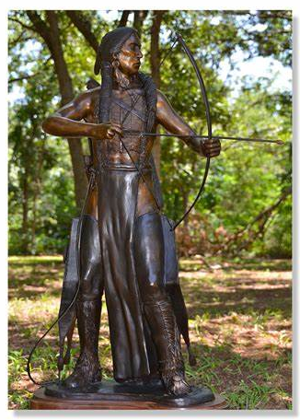
The Story of Standing His Ground statue
Dr. James Utterback, Chapter 9

Slide 41
Thank you!

